Slide 1
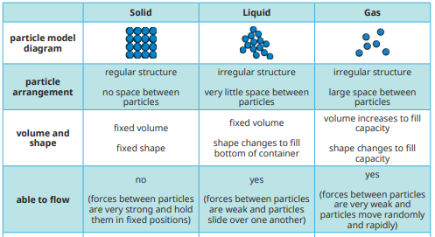
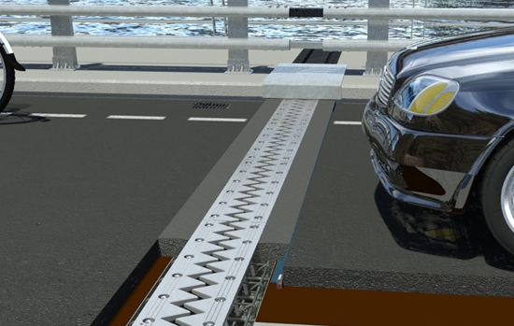
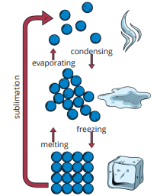
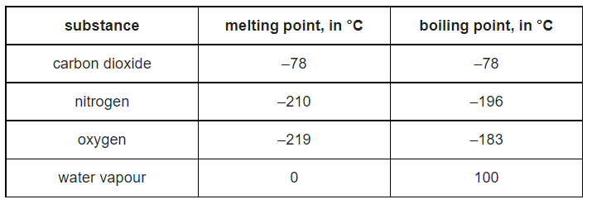
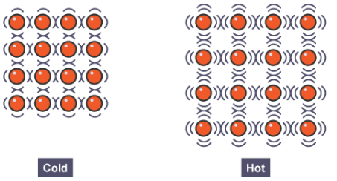


Knowledge Organiser
Year 8: Heating and Cooling – Matter and Thermal Energy
A table which summarises the particle arrangement, volume, shape and ability to flow of solids, liquids and gases
This picture shows expansion joints on a bridge which help to stop it from breaking on hot days
States of matter
There are three states of matter; solids, liquids and gases
Solids have particles which are close together in a regular, repeating pattern
Liquids have particles which are close together but randomly arranged and moving around.
Gases have particles which are far apart and moving quickly around
Diagram which shows the changes of state and the particle arrangement of solids, liquids and gases
How does an expansion joint work?
On warmer days the metal expands and fills the joint
If it wasn’t there the bridge materials might push against each other and crack
The table below shows the melting and boiling points of four different gases
At -185⁰C the substances would be in these states of matter:
Carbon dioxide – Solid, it is below the melting point
Nitrogen – Gas, it is above the boiling point
Oxygen – Liquid, it is above the melting point but below the boiling point
Water vapour – Gas, it is above the boiling point
How is temperature different to thermal energy?
Thermal energy is a measure of the total energy of the particles
Temperature is a measure of the average kinetic energy of the particles in a substance
A high temperature makes a substance hotter because the particles gain kinetic energy
What happens when particles lose or gain energy?
When particles gain energy the particles will move more quickly and spread further apart
When particles lose energy the particles will move more slowly and get closer together
We say that a substance will expand when it gets warmer and condense when it gets cooler
RAG Yourself!
Changes of state
When a substance gains or loses enough energy it can change state
When water reaches 100⁰C it will boil, we call this its boiling point
When water reaches 0⁰C it will freeze, we call this its freezing/melting point
Learning Outcomes; | RAG
Recall the three states of matter and four changes of state
State the boiling and freezing point of water
Describe the movement and arrangement of particles in each state
Explain expansion and contraction
Describe what happens to particles in a substance when it is heated
Compare temperature to thermal energy in terms of kinetic energy of particles

Slide 2
Knowledge Organiser
Year 8: Heating and Cooling – Matter and Thermal Energy
A table which summarises the particle arrangement, volume, shape and ability to flow of solids, liquids and gases
This picture shows expansion joints on a bridge which help to stop it from breaking on hot days
States of matter
Diagram which shows the changes of state and the particle arrangement of solids, liquids and gases
How does an expansion joint work?
The table below shows the melting and boiling points of four different gases
At -185⁰C the substances would be in these states of matter:
How is temperature different to thermal energy?
What happens when particles lose or gain energy?
RAG Yourself!
Changes of state
Learning Outcomes; | RAG
Recall the three states of matter and four changes of state
State the boiling and freezing point of water
Describe the movement and arrangement of particles in each state
Explain expansion and contraction
Describe what happens to particles in a substance when it is heated
Compare temperature to thermal energy in terms of kinetic energy of particles

